Slide 1
Team jBehaving
Ashly Finger, Bai Xiong, Cody Lanier, Cody Prior, Daniel Gallegos, Michel Watson

Slide 2
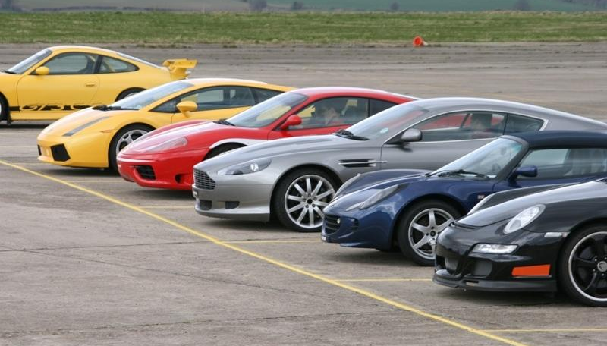

Got Track Days, Inc.
Sponsor: Juan Calderon
Business Model:
Track Day Organizer
Project Aim:
Website and registration system for attendees
Provide maximum track time
per dollar

Slide 3
Use Case Model
Access Account
Register Account
Standard Employee
Guest
Search Events
Generate Financial Reports
Accountant
Member
Manage Internal Accounts
Manage Track Day Events
Event Manager
Manage Garage
Owner
Register for Events
HR

Slide 4
Manage Track Day Events Expanded
Manage Track Day Events
Create Event
Update Event
Delete Event

Slide 5
Manage Garage Expanded
Manage Garage
Create Garage Vehicle
Update Garage Vehicle
Delete Garage Vehicle

Slide 6
Thank you
Questions/Comments?

